Slide 1
5/25/2022

Slide 2
Last Week
Touch base with kyle and find good assembly
Print design
2 designs, fins and bias
Work on whatever kyle didn’t finish
Helix exploration
Refine 3 chamber design

Slide 3
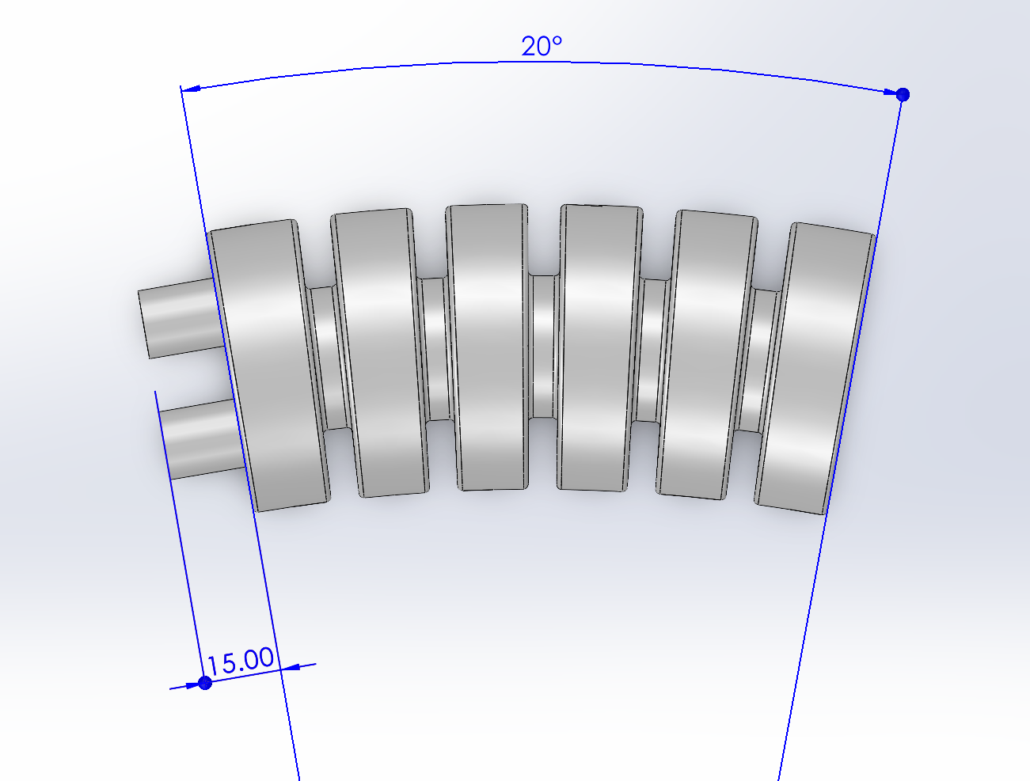
Biased model
20 degree bend added to Kyle’s printed model

Slide 4
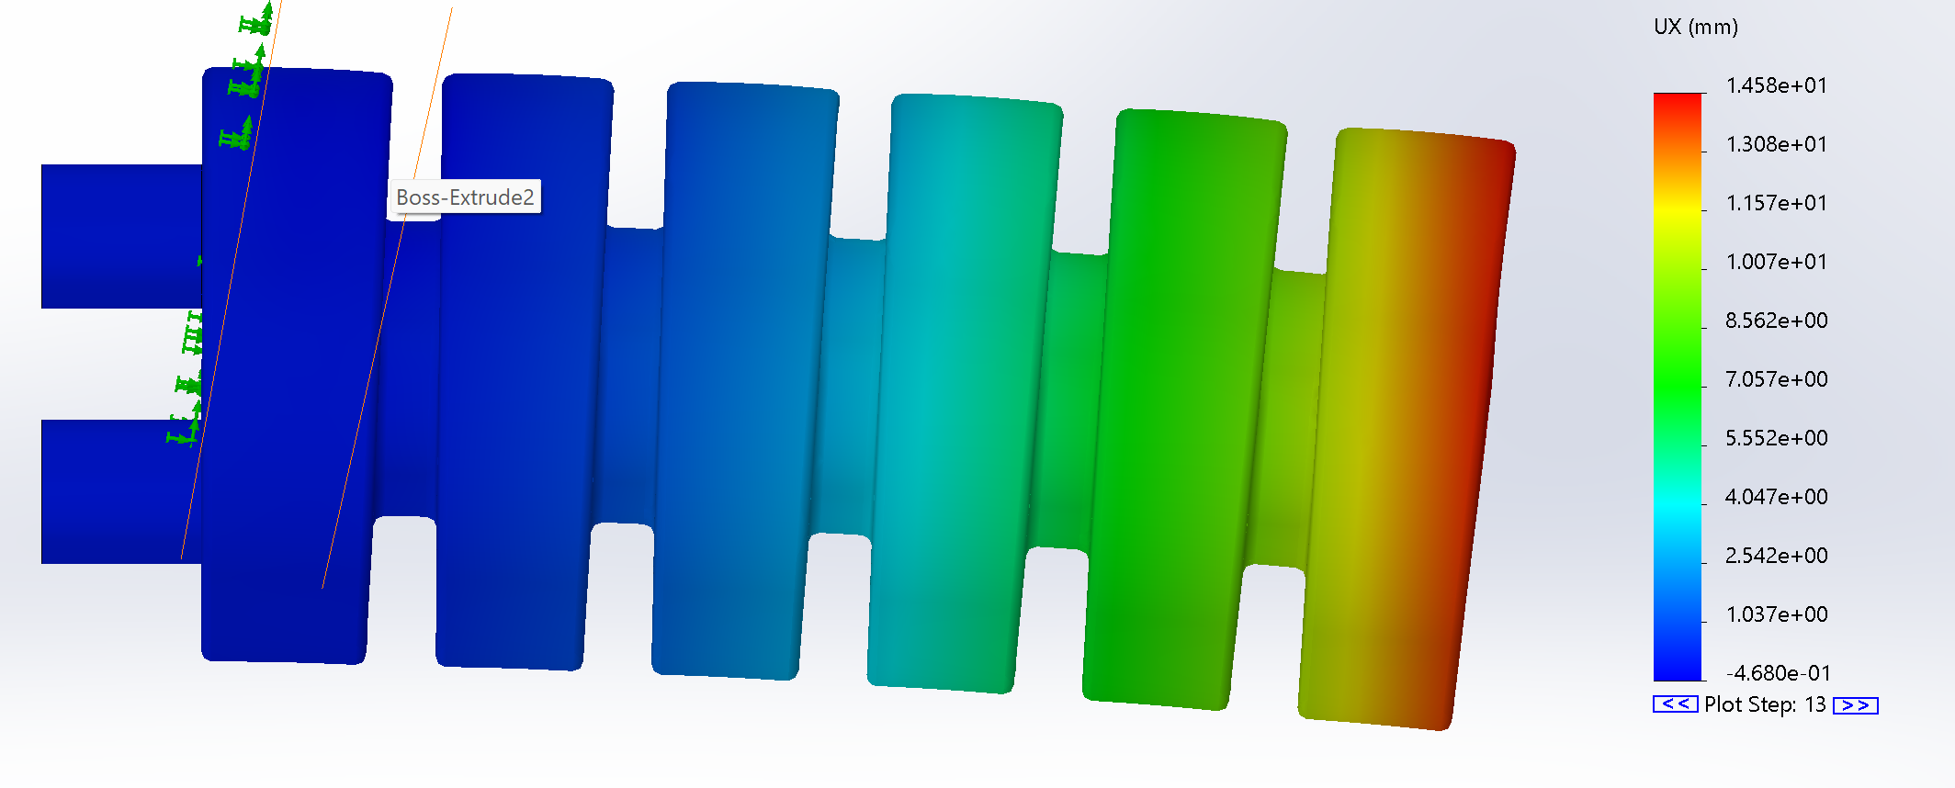
Biased model with vacuum

Slide 5
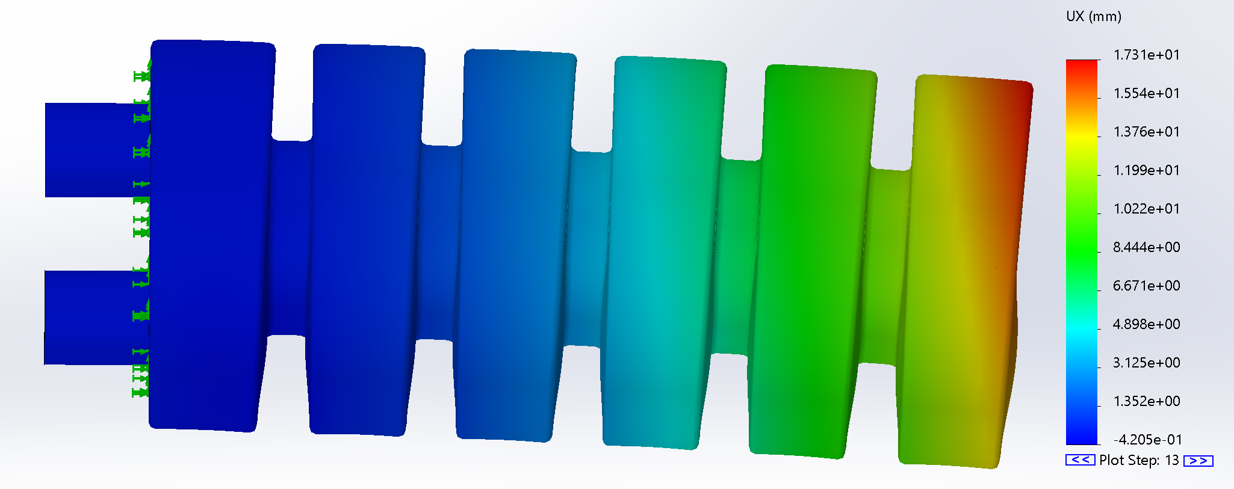
Bottom chambers pressurized

Slide 6
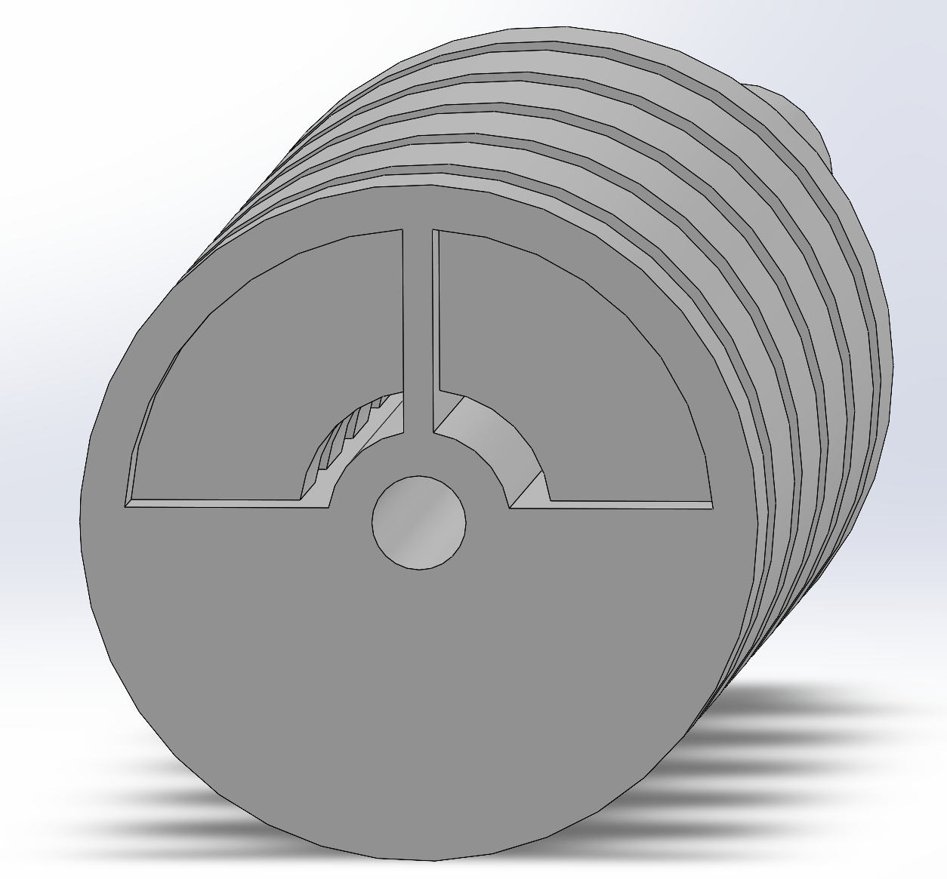
Fin Model

Slide 7
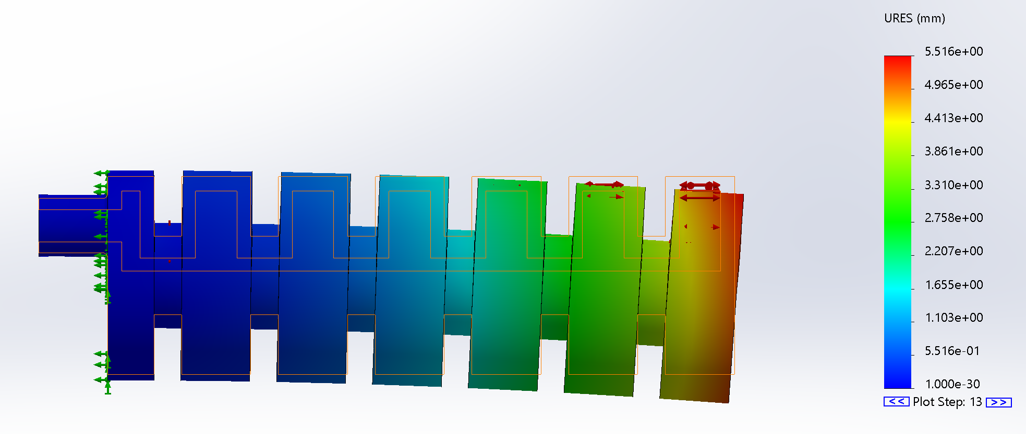
Fin Model

Slide 8
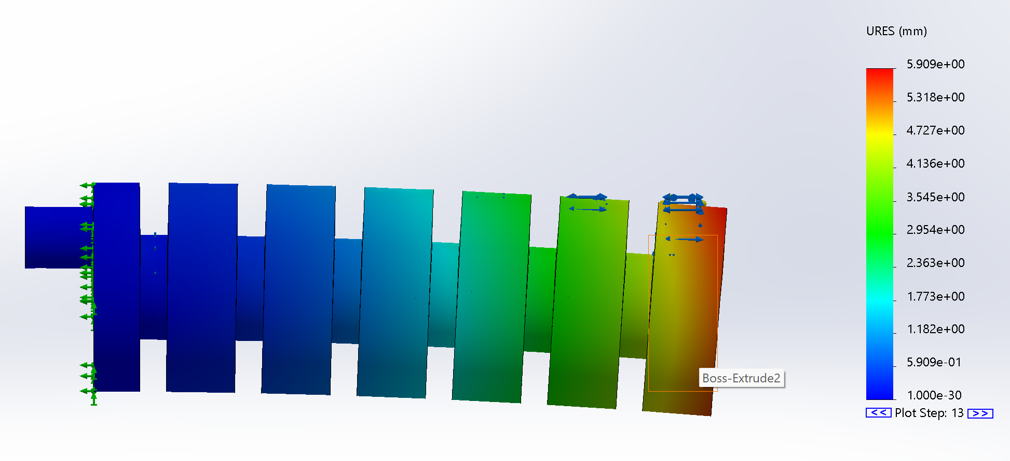
Non fin model for control

Slide 9
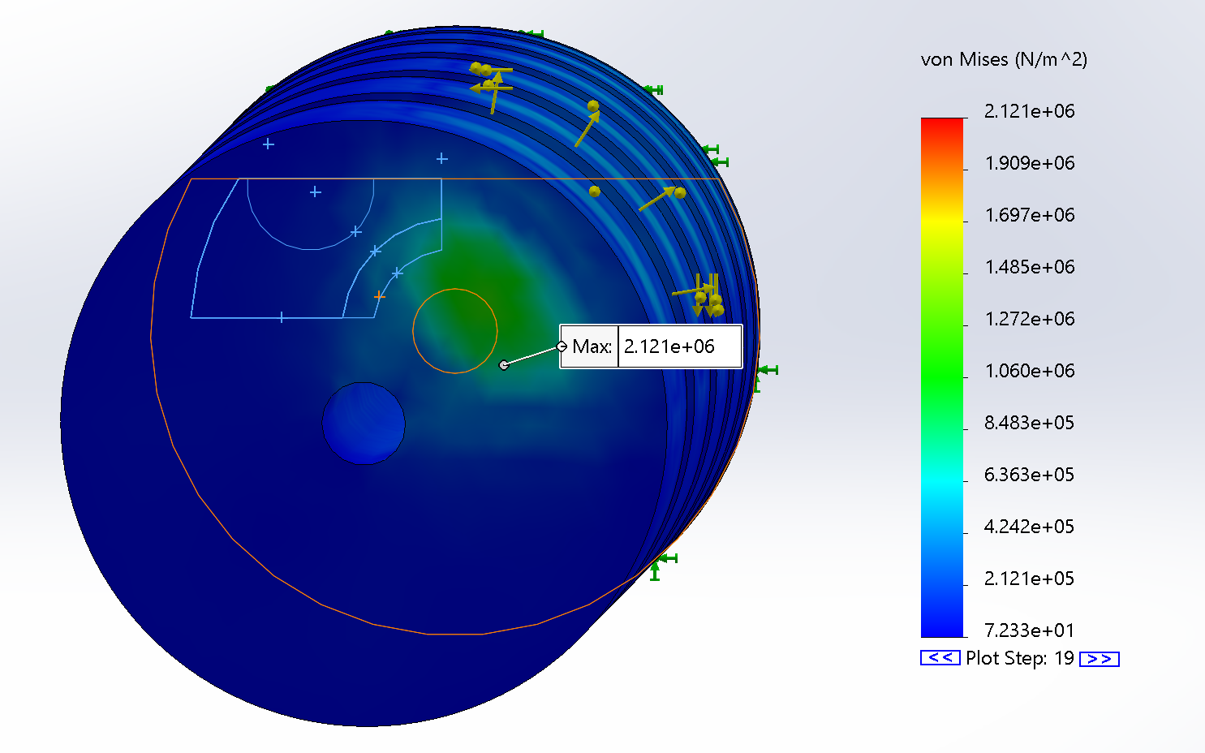
Fin One Chamber

Slide 10
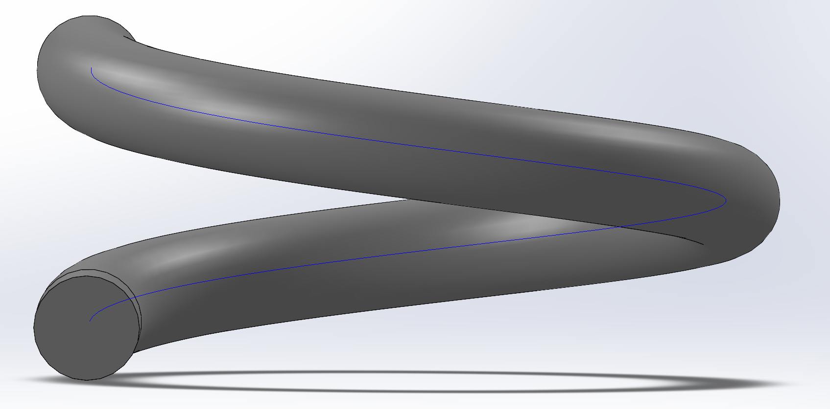
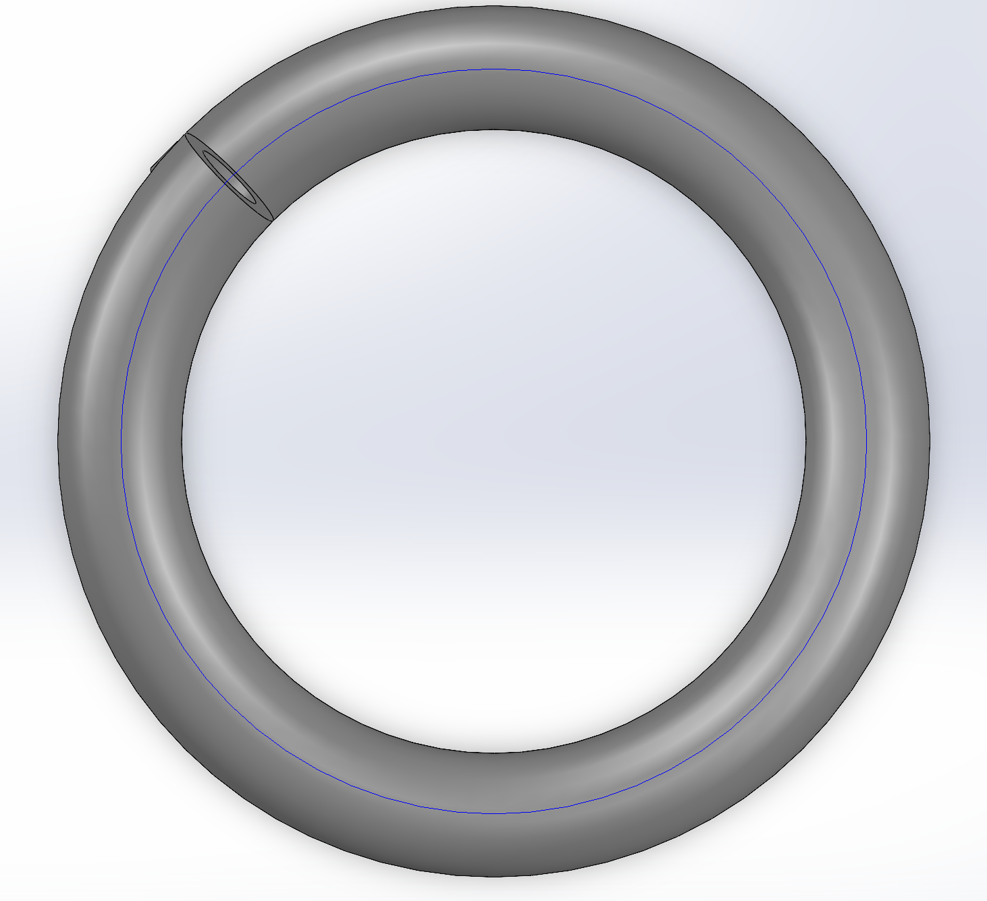
Helix
24 mm pitch 1 cm OD 6mm ID Centered Hole

Slide 11
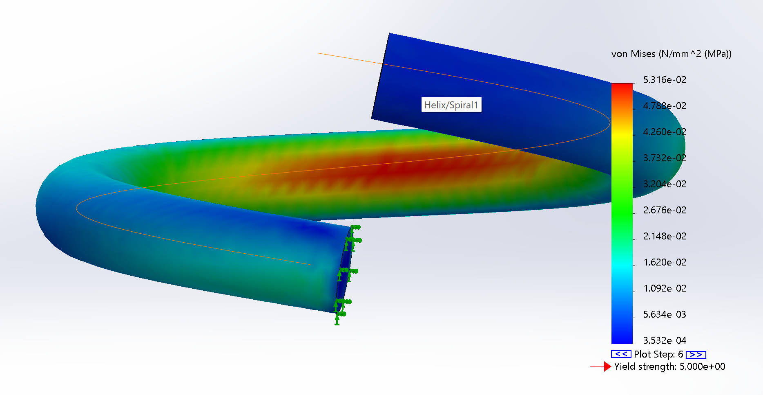

Slide 12
For Next Week
Develop two new models
Biased model with cylindric pieces not using flex tool
Fin design without fins
Rebuild 3 chamber to proper spec
Simulate the four models (two above, 3 and 4 chamber designs)
Run same simulations on all models to draw comparisons
More iterations of the Helix (square)
Follow up with Ally about print request Friday early or Thursday late
Check in with Kyle about simulations on his models to check validity

